Slide 1
DTSA 5301 NYC Shooting Data Report
Manu Balasubramanian

Slide 2
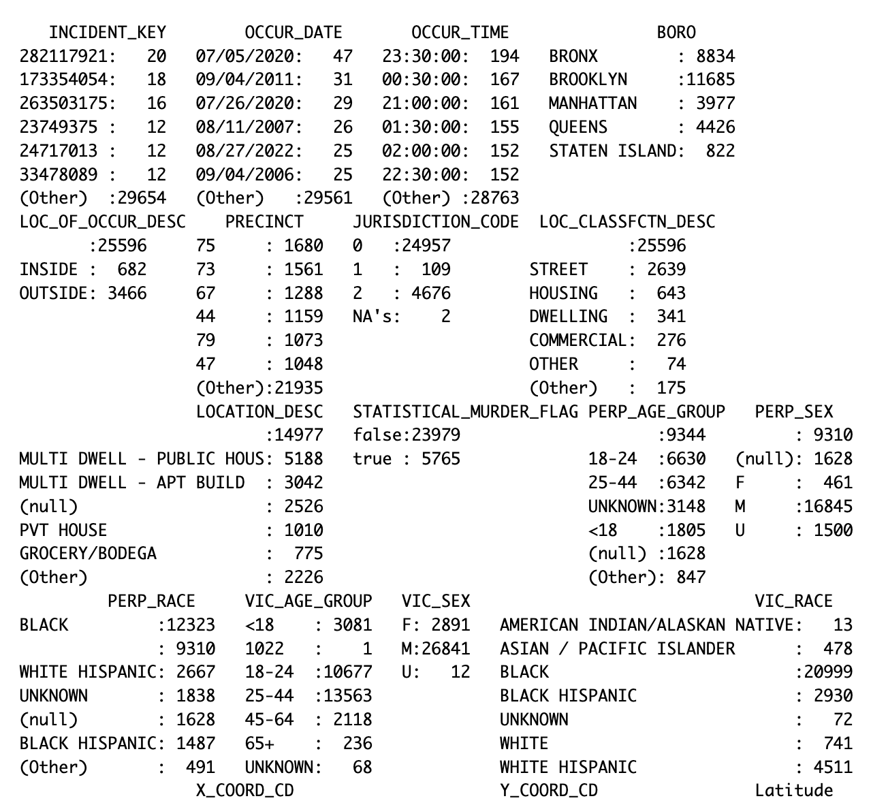
Summary of the Data
Columns of interest: Occur Date, Boro, Statistical Murder Flag, Race, Gender, Age

Slide 3
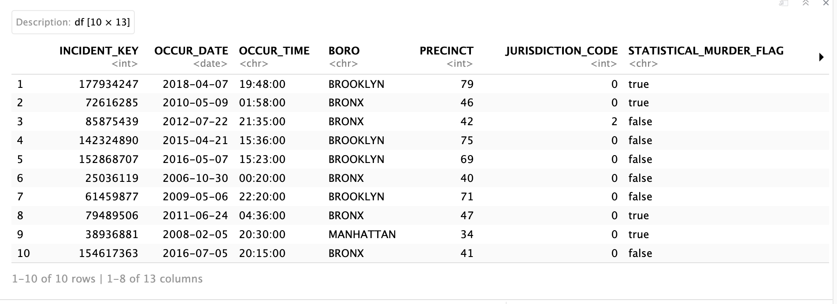
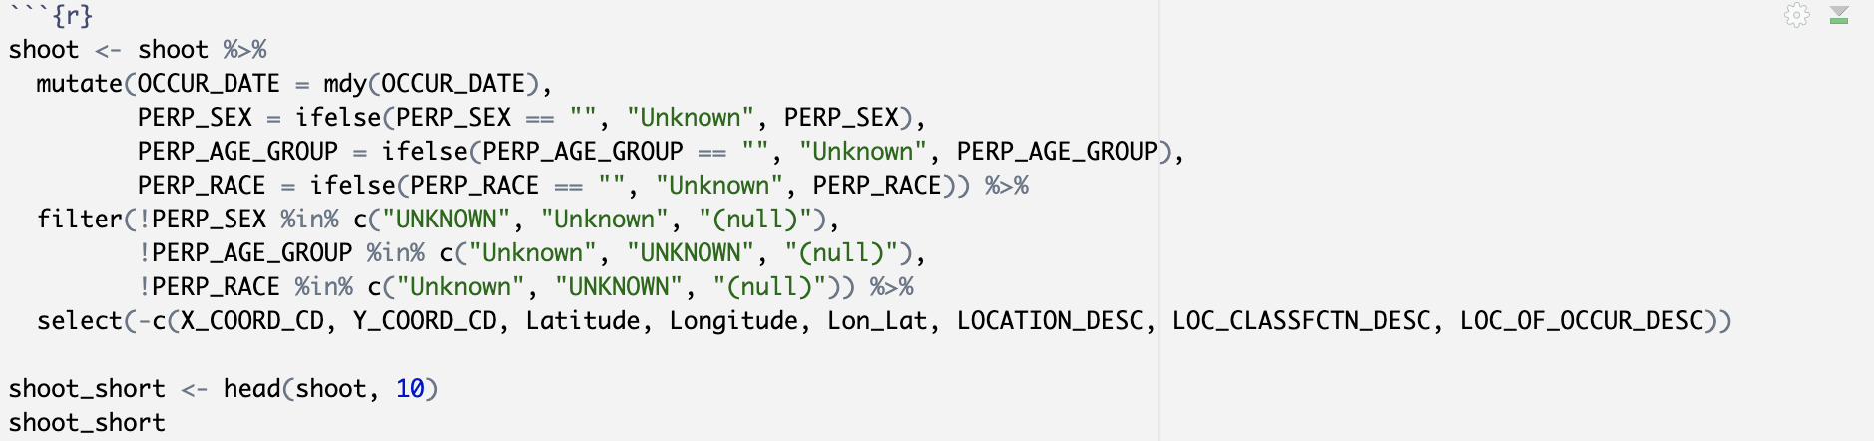
Data Cleaning
Head of the cleaned data set named shoot used for data analysis.

Slide 4
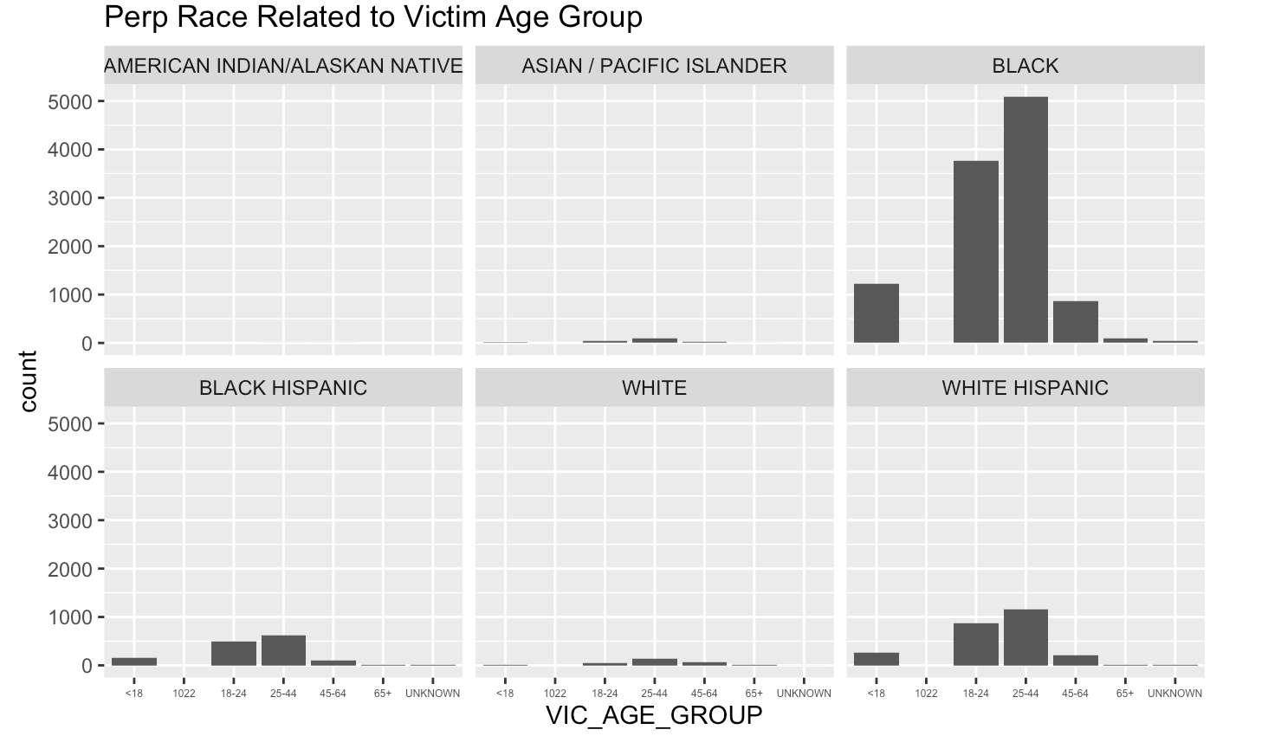
Visualizations: Age Group and Race
Bar graph displays the number of shooters per age group faceted over the race column.

Slide 5
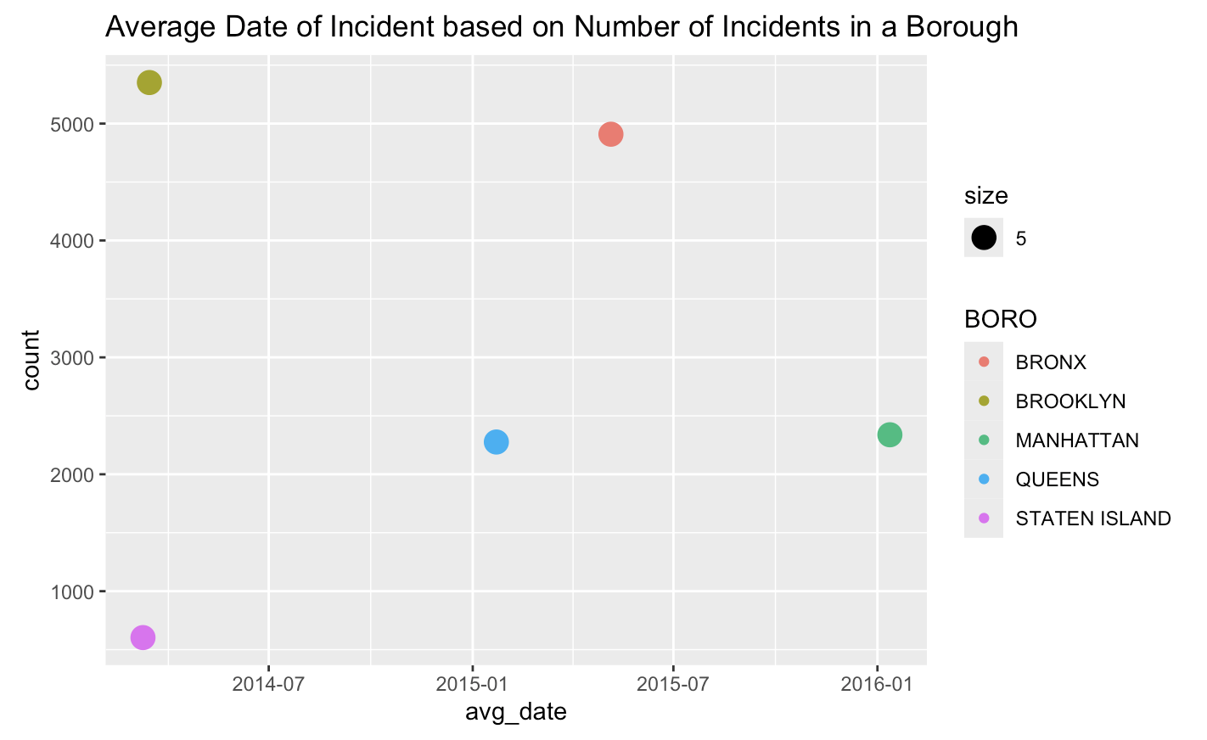
Visualizations: Average Date in Each Borough
Scatter plot shows the average date of the incidents compared to the total number of incidents in each borough.

Slide 6
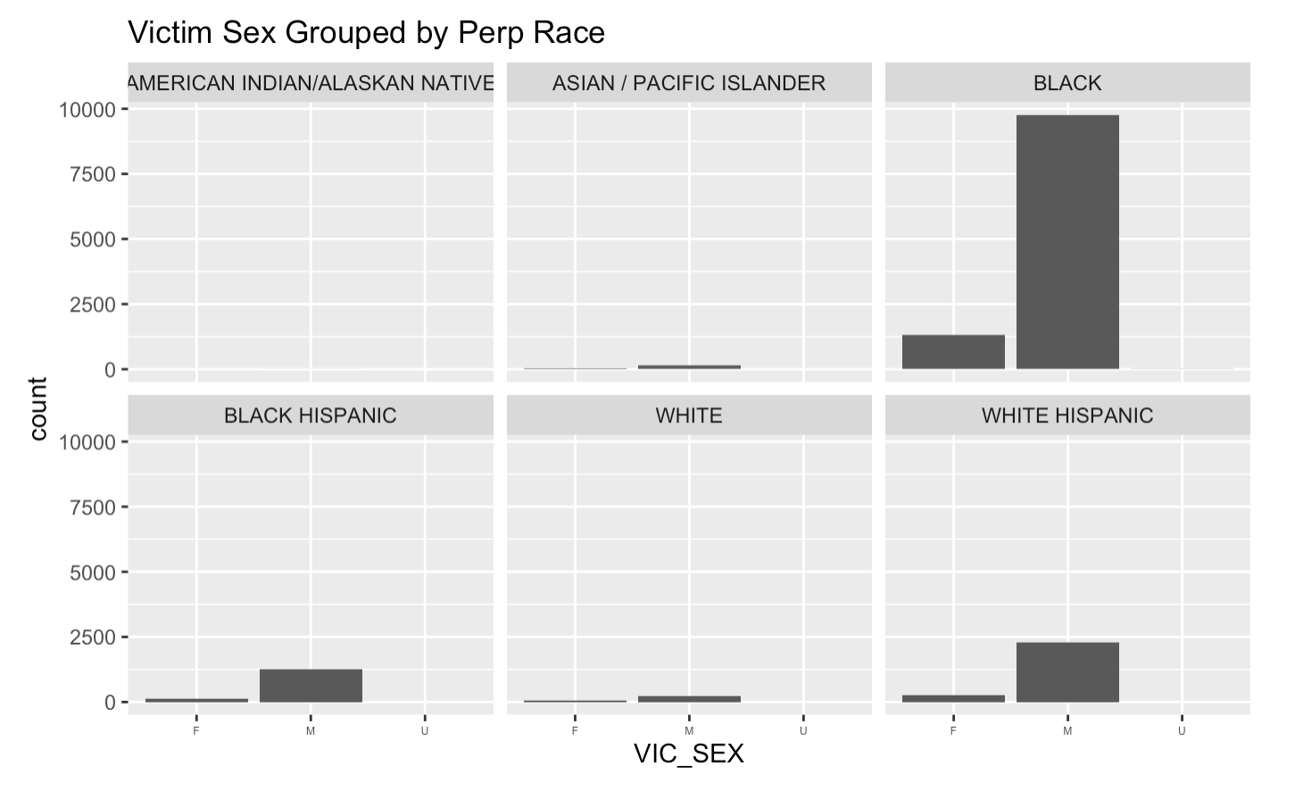
Visualizations: Perp Race and Sex
Bar plot shows the count of victim sex faceted against the perpetrator race.

Slide 7
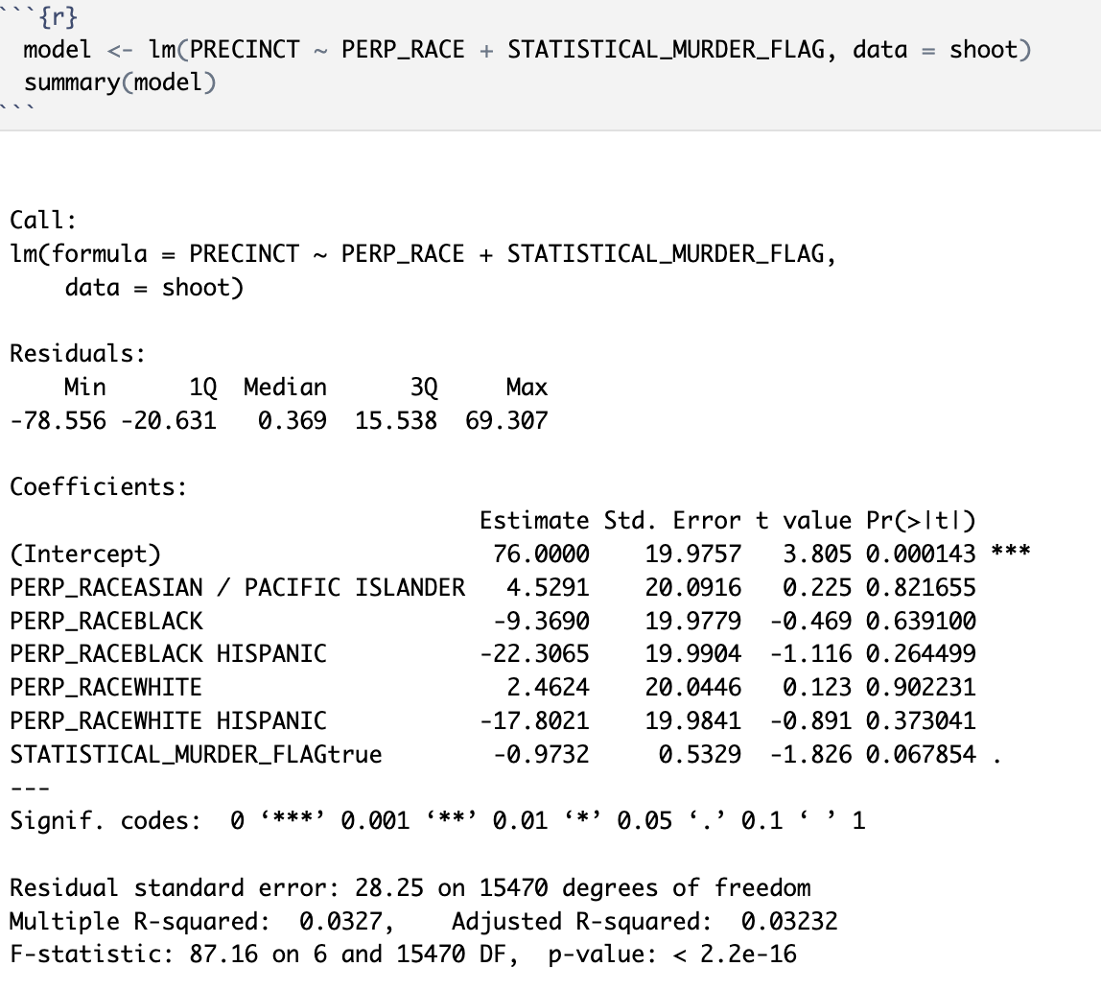
Model and Bias
Model was created using precinct, perp_race, and the murder flag to determine if the was a linear relationship between these columns.
Race and Gender Bias exist within this analysis

